Slide 1

Bài 5: Collection(List, Tree, Map, Set….), Mảng và lệnh lặp
Giảng viên: Nguyễn Quang Huy
Email: HuyNQ12@topica.edu.vn
‹#›

Slide 2
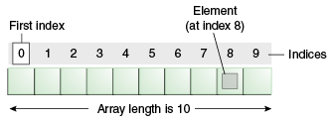
Array in Java
Normally, array is a collection of similar type of elements that have contiguous memory location
Java array is an object the contains elements of similar data type
a data structure where we store similar elements
can store only fixed set of elements
index based, first element of the array is stored at 0 index
‹#›
Notes:
vị trí bộ nhớ tiếp giáp

Slide 3
Array in Java (continue)
Advantage
Code Optimization: It makes the code optimized, we can retrieve or sort the data easily
Random access: We can get any data located at any index position
Disadvantage
Size Limit: We can store only fixed size of elements in the array. It doesn't grow its size at runtime. To solve this problem, collection framework is used in java
Types of Array
Single Dimensional Array
Multidimensional Array
‹#›

Slide 4
Collections in Java
Collection represents a single unit of objects i.e. a group
A framework that provides an architecture to store and manipulate the group of objects
searching, sorting, insertion, manipulation, deletion ...
Collection framework represents a unified architecture for storing and manipulating group of objects. It has
Interfaces and its implementations i.e. classes
Algorithm
‹#›

Slide 5
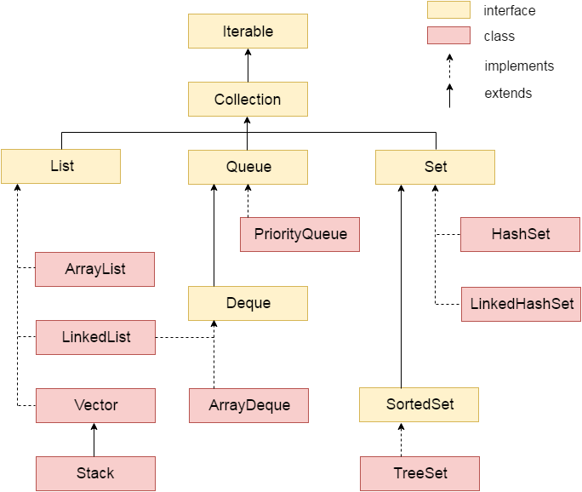
Hierarchy of Collection Framework
4

Slide 6
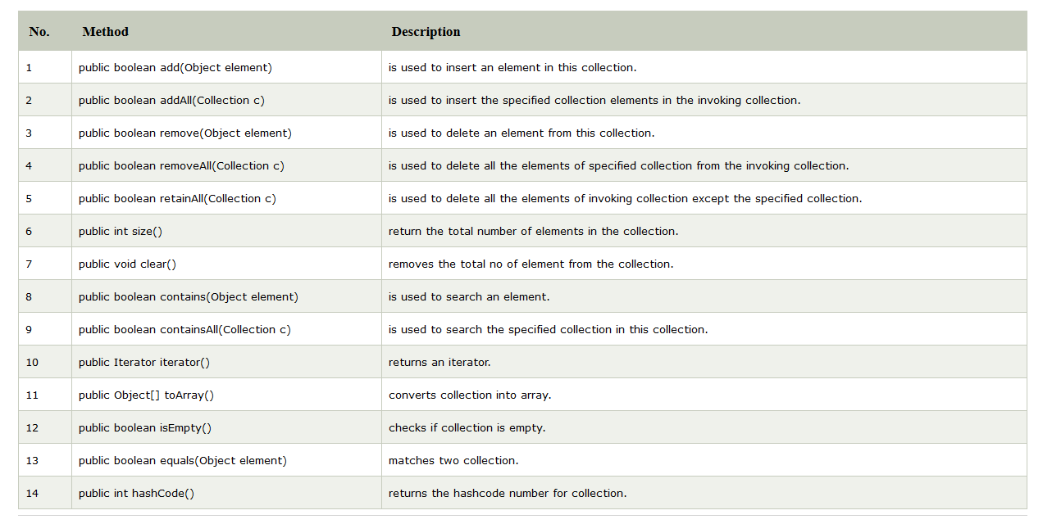
Methods of Collection interface
‹#›

Slide 7
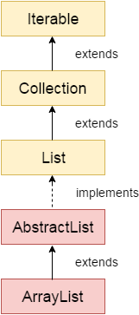
List - ArrayList class
Uses a dynamic array for storing the elements
About ArrayList
can contain duplicate elements
maintains insertion order
is non synchronized
allows random access because array works at the index basis
manipulation is slow because a lot of shifting needs to be occurred if any element is removed from the array list
‹#›

Slide 8
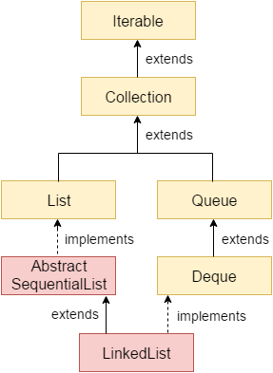
List - LinkedList class
Uses doubly linked list to store the elements, provides a linked-list data structure
About LinkedList
can contain duplicate elements
maintains insertion order
is non synchronized
manipulation is fast because no shifting needs to be occurred
can be used as list, stack or queue.
‹#›

Slide 9
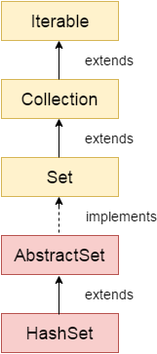
Set - HashSet class
Is used to create a collection that uses a hash table for storage
About HashSet
stores the elements by using a mechanism called hashing
contains unique elements only
Difference between List and Set
List can contain duplicate elements whereas Set contains unique elements only
‹#›

Slide 10
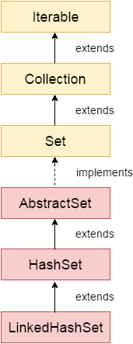
Set - LinkedHashSet class
Is a Hash table and Linked list implementation of the set interface.
Inherits HashSet class and implements Set interface
About LinkedHashSet
contains unique elements only like HashSet
provides all optional set operations, and permits null elements
maintains insertion order
‹#›

Slide 11
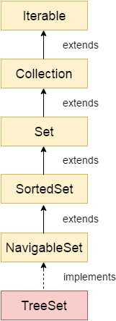
Set - TreeSet class
Implements the Set interface that uses a tree for storage.
Inherits AbstractSet class and implements NavigableSet interface.
The objects of TreeSet class are stored in ascending order
About TreeSet
Contains unique elements only like HashSet
Access and retrieval times are quiet fast
Maintains ascending order
‹#›

Slide 12
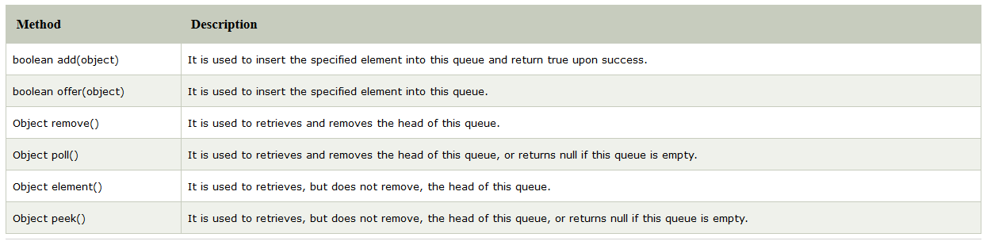
Queue - PriorityQueue class
Java Queue interface orders the element in FIFO(First In First Out) manner.
The PriorityQueue class provides the facility of using queue. But it does not orders the elements in FIFO manner.
‹#›

Slide 13
Deque - ArrayDeque class
Java Deque Interface is a linear collection that supports element insertion and removal at both ends.
The ArrayDeque class provides the facility of using deque and resizable-array
About ArrayDeque
Unlike Queue, we can add or remove elements from both sides
Null elements are not allowed in the ArrayDeque
ArrayDeque is not thread safe, in the absence of external synchronization
ArrayDeque has no capacity restrictions
ArrayDeque is faster than LinkedList and Stack
‹#›

Slide 14
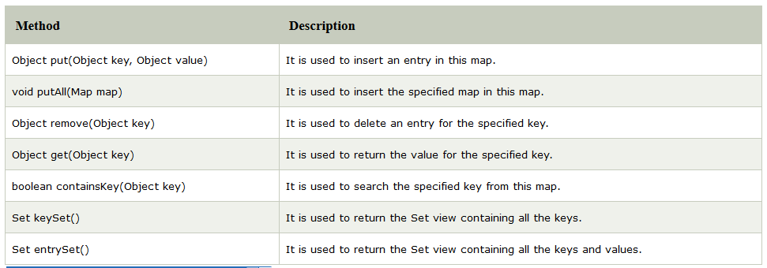
Map - Map Interface
A map contains values on the basis of key i.e. key and value pair. Each key and value pair is known as an entry. Map contains only unique keys.
Map is useful if you have to search, update or delete elements on the basis of key.
‹#›

Slide 15
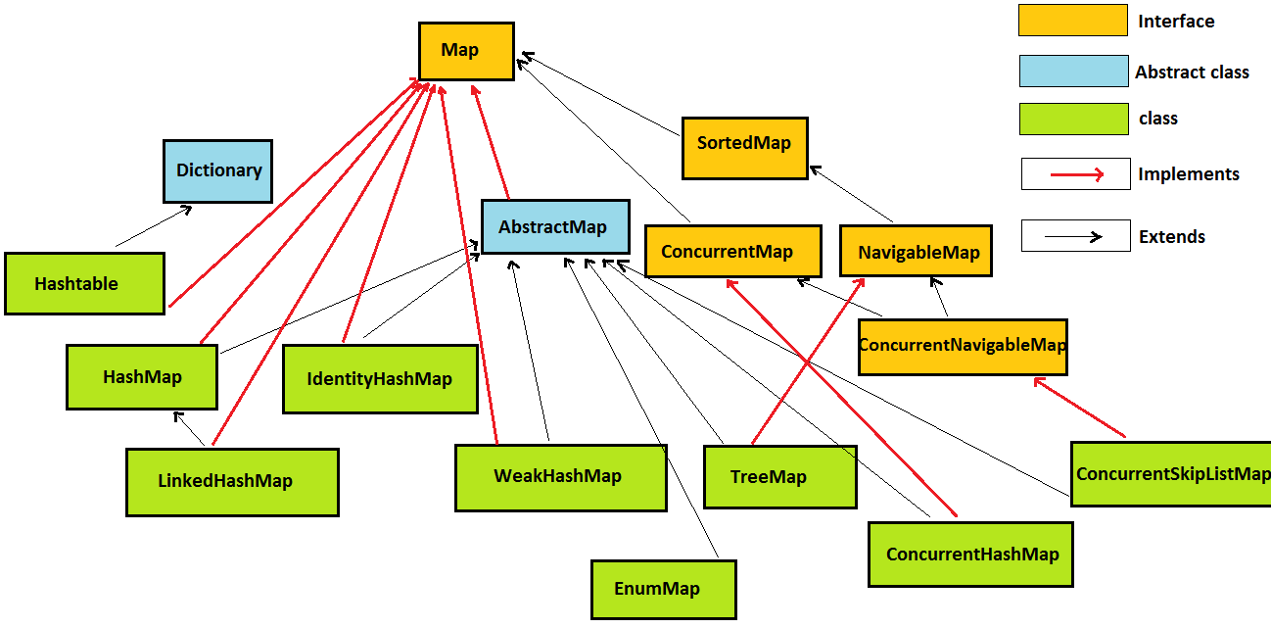
Hierarchy of Map
4

Slide 16
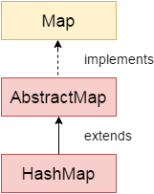
Map - HashMap class
Java HashMap class implements the map interface by using a hashtable
About HashMap
A HashMap contains values based on the key
It contains only unique elements
It may have one null key and multiple null values
It maintains no order
‹#›

Slide 17
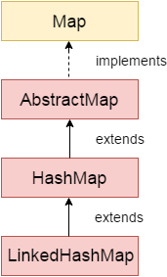
Map - LinkedHashMap class
Java LinkedHashMap class is Hash table and Linked list implementation of the Map interface, with predictable iteration order
About LinkedHashMap
A HashMap contains values based on the key
It contains only unique elements
It may have one null key and multiple null values
It is same as HashMap instead maintains insertion order
‹#›
Notes:
LinkedHashMap(int initialCapacity, float loadFactor, boolean accessOrder)
Constructs an empty LinkedHashMap instance with the specified initial capacity, load factor and ordering mode.
- if accessOrder is false, then it will result in insertion order
- if accessOrder is true, then it will result in access Order, One of the important application of access order LinkedHashMap is building LRU cache.

Slide 18
Map - TreeMap class
Java TreeMap class implements the Map interface by using a tree. It provides an efficient means of storing key/value pairs in sorted order
About TreeMap
A TreeMap contains values based on the key. It implements the NavigableMap interface and extends AbstractMap class
It contains only unique elements
It cannot have null key but can have multiple null values
It is same as HashMap instead maintains insertion order
‹#›

Slide 19
Hashtable class
Hashtable class implements a hashtable, which maps keys to values. It inherits Dictionary class and implements the Map interface
About Hashtable
A Hashtable is an array of list. Each list is known as a bucket. The position of bucket is identified by calling the hashcode() method. A Hashtable contains values based on the key
It contains only unique elements
It may have not have any null key or value
It is synchronized
‹#›

Slide 20
Do you know?
What are the four ways to iterate the elements of a collection?
What is the difference between ArrayList and LinkedList classes in collection framework?
What is the difference between ArrayList and Vector classes in collection framework?
What is the difference between HashSet and HashMap classes in collection framework?
What is the difference between HashMap and Hashtable class?
What is the difference between Iterator and Enumeration interface in collection framework?
How can we sort the elements of an object? What is the difference between Comparable and Comparator interfaces?
What does the hashcode() method?
What is the difference between java collection and java collections?
‹#›
Notes:
1. The Classic For Loop
for (int i = 0; i < listNames.size(); i++) {
String aName = listNames.get(i);
System.out.println(aName);
}
2. The Iterator Method
Set<Integer> numbers = new HashSet<>();
numbers.add(100);
numbers.add(35);
numbers.add(89);
numbers.add(71);
Iterator<Integer> iterator = numbers.iterator();
while (iterator.hasNext()) {
Integer aNumber = iterator.next();
System.out.println(aNumber);
}
3. The Enhanced For Loop
for (String aName : listNames) {
System.out.println(aName);
}
4. The forEach Method with Lambda Expressions
istNames.forEach(name -> System.out.println(name));
Well, in the previous methods (classic for loop, iterator and enhanced for loop), the programmers control how the collection is iterated. The iteration code is not part of the collection itself - it’s written by programmers - hence the term external iteration. In contrast, the new method encapsulates the iteration code in the collection itself, thus the programmers do not have to write code for iterating collections. Instead, the programmers specify what-to-do in each iteration - this is the big difference! Hence the term internal iteration: the collections handle the iteration itself, whereas the programmers pass the action - what needs to do in each iteration
ref: http://www.codejava.net/java-core/collections/the-4-methods-for-iterating-collections-in-java,
http://www.javapractices.com/topic/TopicAction.do?Id=125

Slide 21
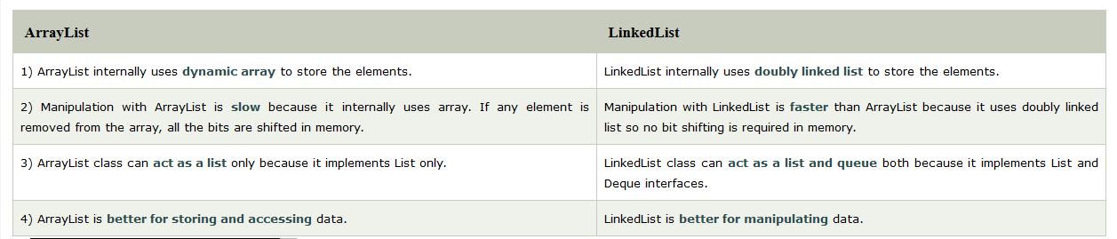
Difference between ArrayList and LinkedList
Both
implements List interface and maintains insertion order
are non synchronized classes
‹#›

Slide 22
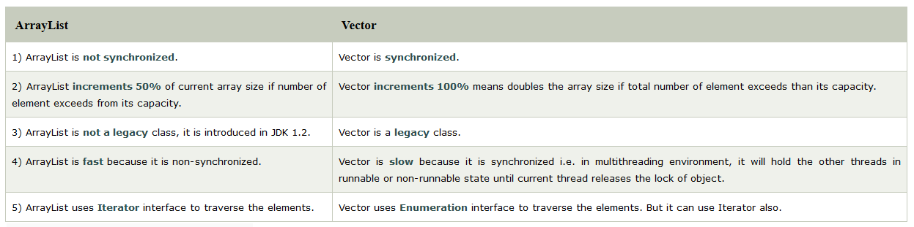
Difference between ArrayList and Vector
Both
implements List interface and maintains insertion order
‹#›

Slide 23
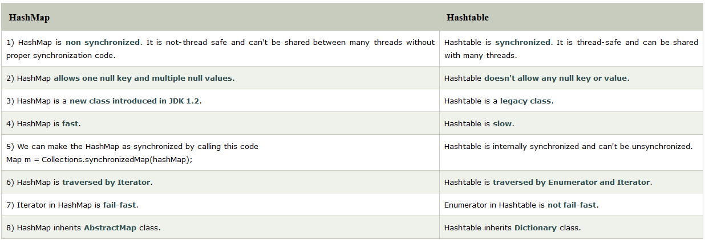
Difference between HashMap and Hashtable
Both
used to store data in key and value form
using hashing technique to store unique keys
‹#›

Slide 24
Sort the elements of an object
Java Comparator interface is used to order the objects of user-defined class
This interface is found in java.util package and contains 2 methods
compare(Object obj1,Object obj2)
equals(Object element)
Collections class provides static methods for sorting the elements of collection
public void sort(List list, Comparator c): is used to sort the elements of List by the given Comparator
‹#›

Slide 25
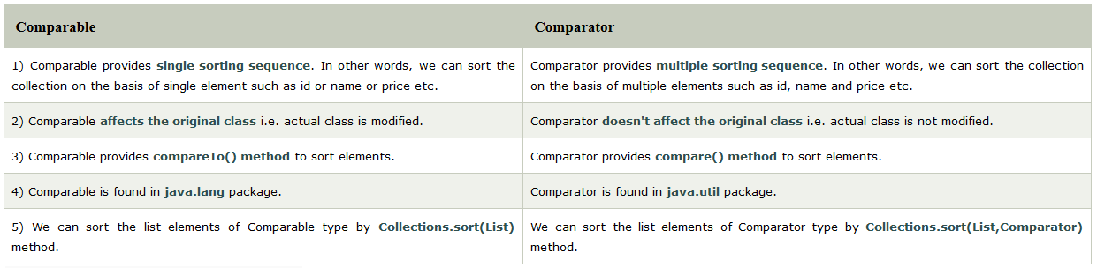
Difference between Comparable and Comparator
Both
are interfaces and can be used to sort collection elements
‹#›

Slide 26
Java Properties class
The properties object contains key and value pair both as a string
The java.util.Properties class is the subclass of Hashtable
can be used to get property value based on the property key
provides methods to get data from properties file and store data into properties file
can be used to get properties of system
Advantage of properties file
recompilation is not required, if information is changed from properties file
‹#›

Slide 27

‹#›
Notes:
test online → https://www.javatpoint.com/directload.jsp?val=92

